Slide 1


Further applications
Center for Animal Disease Modeling and Surveillance (CADMS),
School of Veterinary Medicine, UC Davis
Jose Pablo Gomez*, Jerome Baron,
Beatriz Martinez-Lopez
Center for Animal Disease Modeling and Surveillance (CADMS)
Department of Medicine & Epidemiology
School of Veterinary Medicine
University of California, Davis
* Presenter: Email: jpgo@ucdavis.edu
https://cadms.vetmed.ucdavis.edu

Slide 2
Outline
Statistical Models
Simulation Models

Slide 3
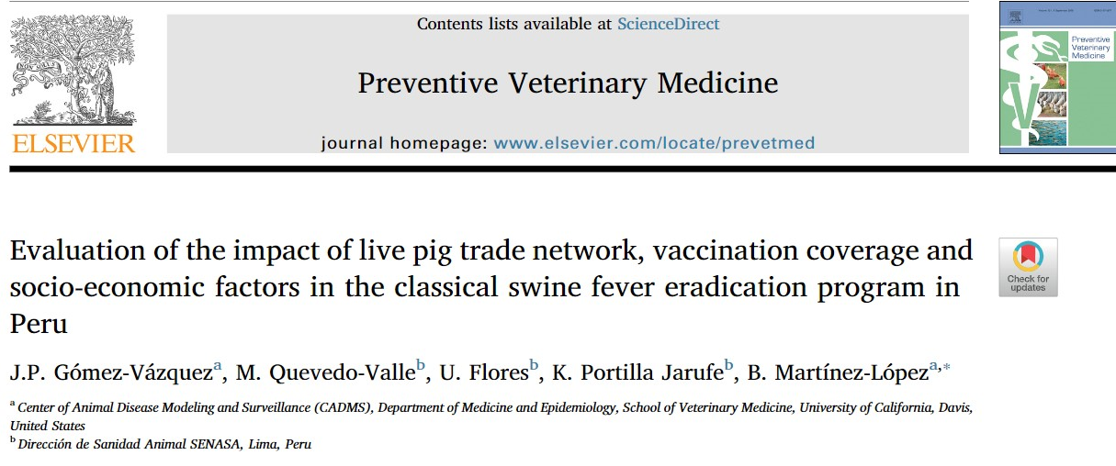
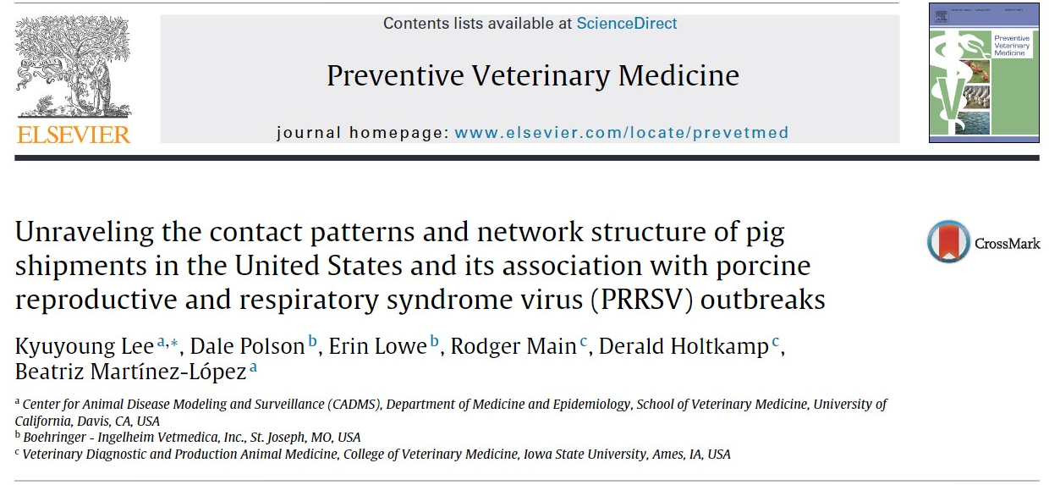
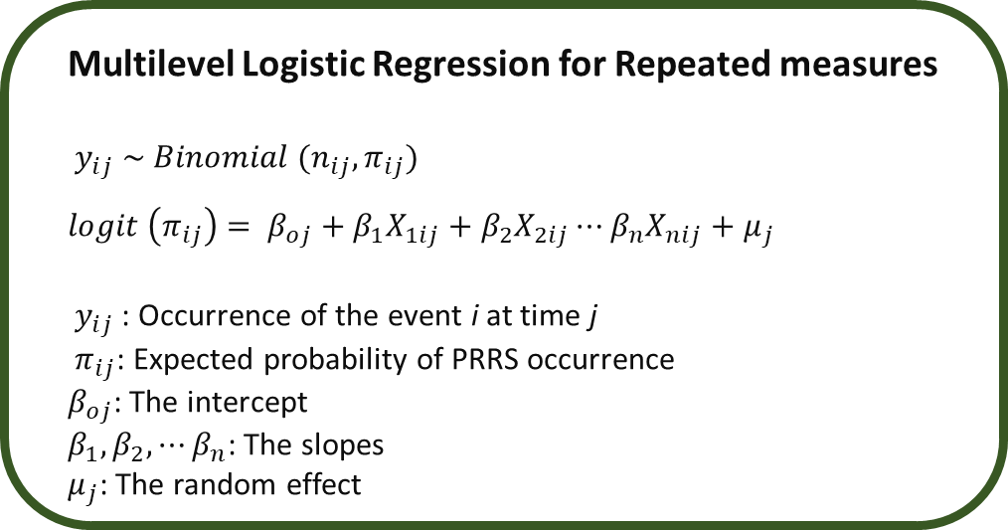
Network Analysis and Regression
Regression assumptions:
Linearity
Independence
Normality
Equal variance
SNA recognize the influence of community members on each other.
i.i.d
Multilevel Logistic Regression for Repeated measures
$y_{ij} \sim Binomial (n_{ij},π_{ij})$
$logit \left(π_{ij}\right)$ $= β_{oj}+β_{1}X_{1ij}+β_{2}X_{2ij}⋯β_{n}X_{nij}+μ_{j}$
$y_{ij}$: Occurrence of the event i at time j
$π_{ij}$: Expected probability of PRRS occurrence
$β_{oj}$: The intercept
$β_{1}, β_{2}, ⋯β_{n}$: The slopes
$μ_{j}$: The random effect
Notes:
Independent Identically Distributed

Slide 4
ERGMs
Exponential Random Graph Models: Predicting dichotomous ties. What is the probability of observing our network?
Evaluate a cross sectional structure
Network structure: If Farm A contacts Farm B, and Farm B contacts Farm A, what are the chances of farm A contacting Farm B? (Triangles formations)
Individual covariates: are sow farms more likely to contact GDUs?
A
B
A
B
D
C
C
ergm https://www.jstatsoft.org/article/view/v024i03

Slide 5
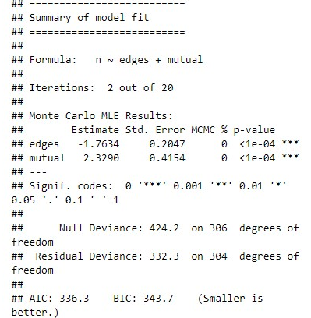
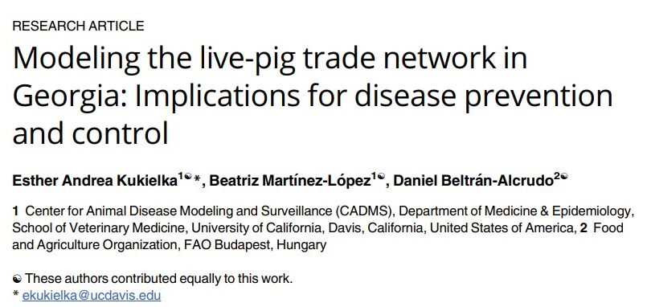
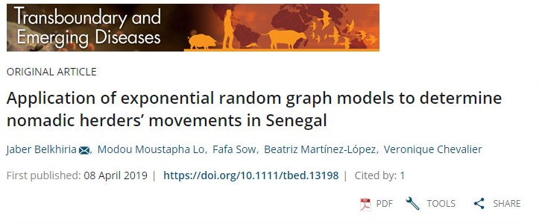
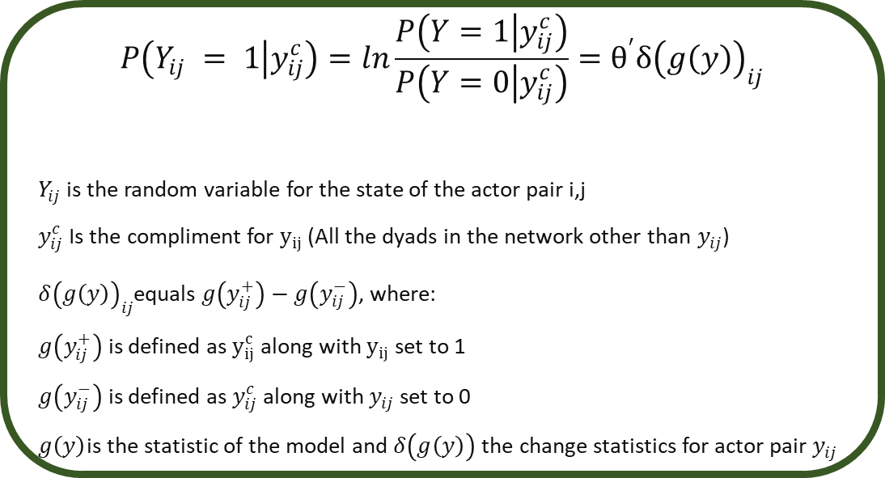
Exponential Random Graph Models
$$P\left(Y_{ij} = 1 | y_{ij}^{c}\right)=ln\frac{P\left(Y=1 | y_{ij}^{c}\right)}{P\left(Y=0 | y_{ij}^{c}\right)}=θ^{′}δ{\left(g\left(y\right)\right)}_{ij}$$
$Y_{ij}$is the random variable for the state of the actor pair i,j
$y_{ij}^{c}$Is the compliment for $y_{ij}$ (All the dyads in the network other than $y_{ij}$)
$δ{\left(g\left(y\right)\right)}_{ij}$equals $g\left(y_{ij}^{+}\right)−g\left(y_{ij}^{−}\right)$, where:
$g\left(y_{ij}^{+}\right)$ is defined as $y_{ij}^{c}$ along with $y_{ij}$ set to 1
$g\left(y_{ij}^{−}\right)$ is defined as $y_{ij}^{c}$ along with $y_{ij}$ set to 0
$g\left(y\right)$is the statistic of the model and $δ\left(g\left(y\right)\right)$ the change statistics for actor pair $y_{ij}$

Slide 6
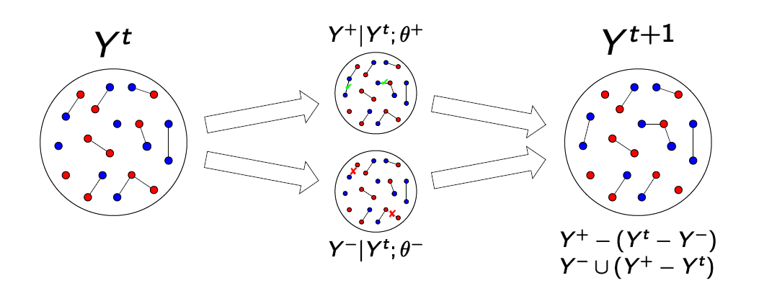
STERGMs
Separable Temporal ERGM
Y⁺ = network in the formation process after evolution
Y⁻ = network in the dissolution process after evolution
This is the origin of the “S” in STERGM

Slide 7
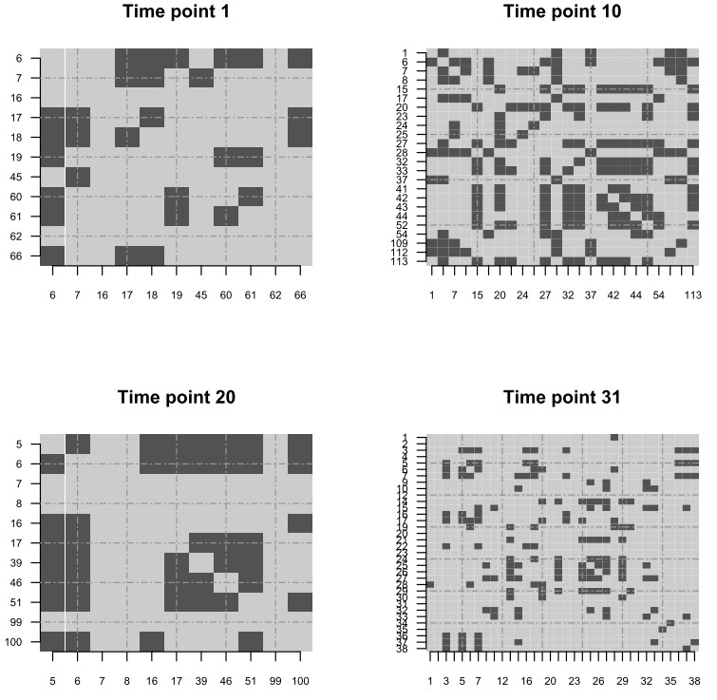
Dynamic Network Regression
Dynamic Network Regression:
https://cran.r-project.org/web/packages/dnr/dnr.pdf
Notes:
Independent Identically Distributed

Slide 8
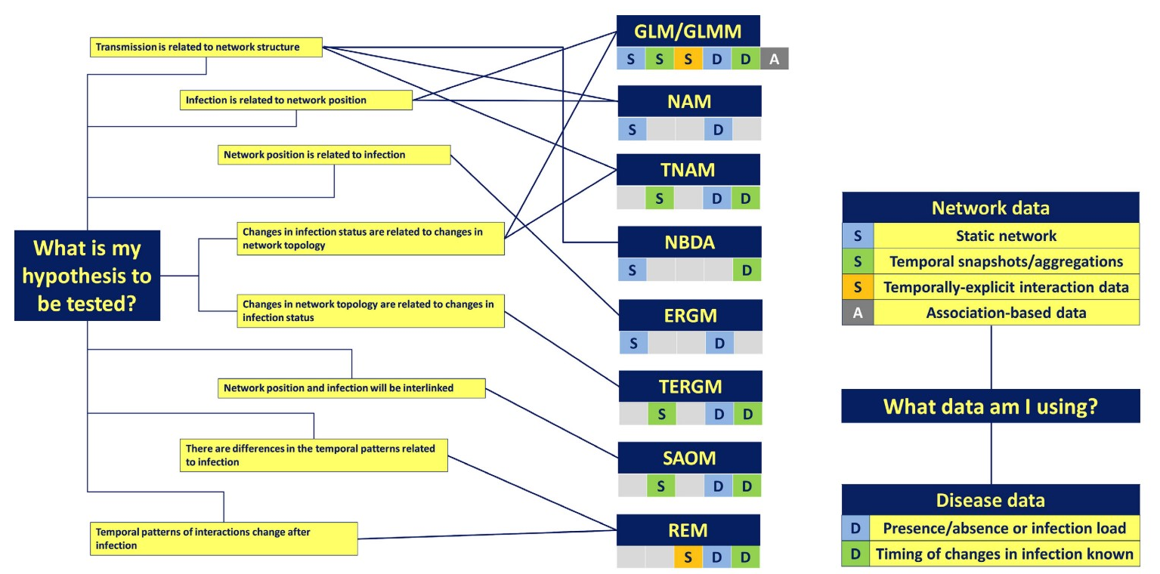
Statistical Models inNetwork Analysis
GLM Generalized linear model
GLMM Generalized linear mixed model
NAM Network autocorrelated model
TNAM temporal autocorrelated model
ERGM exponential random graph model
NBDA Network based diffusion analysis
SAOM stochastic actor-oriented model
TERGM Temporal ERGM
REM Relational events model
Matthew J. Silk 2017
Notes:
Independent Identically Distributed

Slide 9
Disease spread models
Most epidemic models incorporate homogenous mixing assumption (Law of mass action).
This for some scenarios this assumption is unrealistic but simplifies the mathematical computation of the model.
Populations are not homogenously mixed, population structure can arise from spatial and social interactions.
β
γ
S
I
R

Slide 10
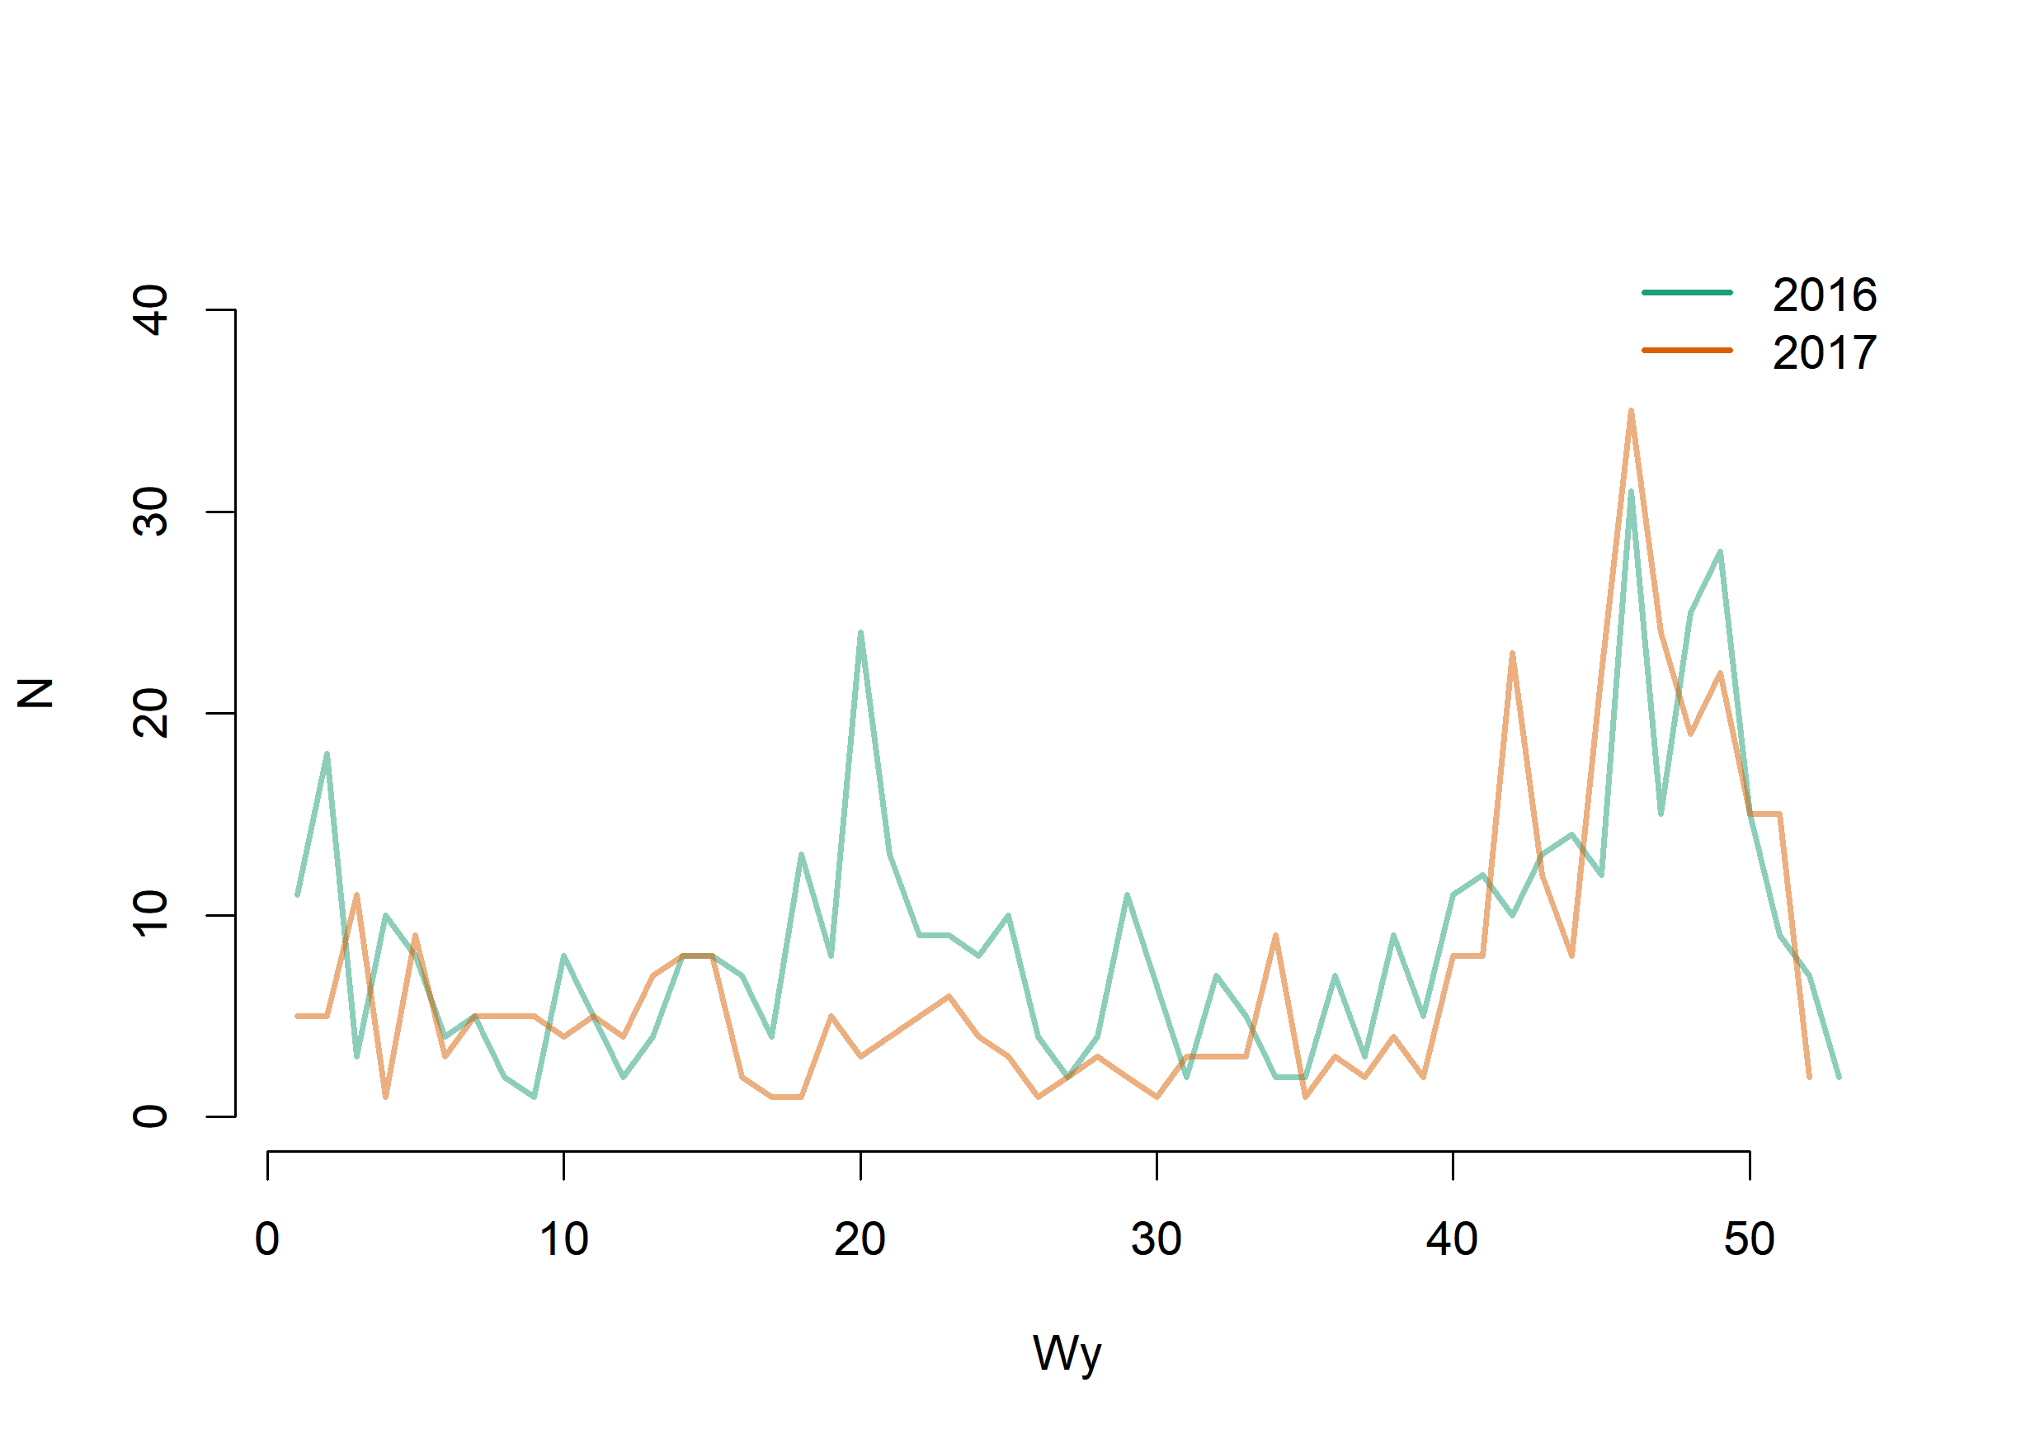
Disease spread models
S
I
R
3
10
S
I
R
5
S
I
R
S
I
R
2
6
4
S
I
R
S
I
R

Slide 11
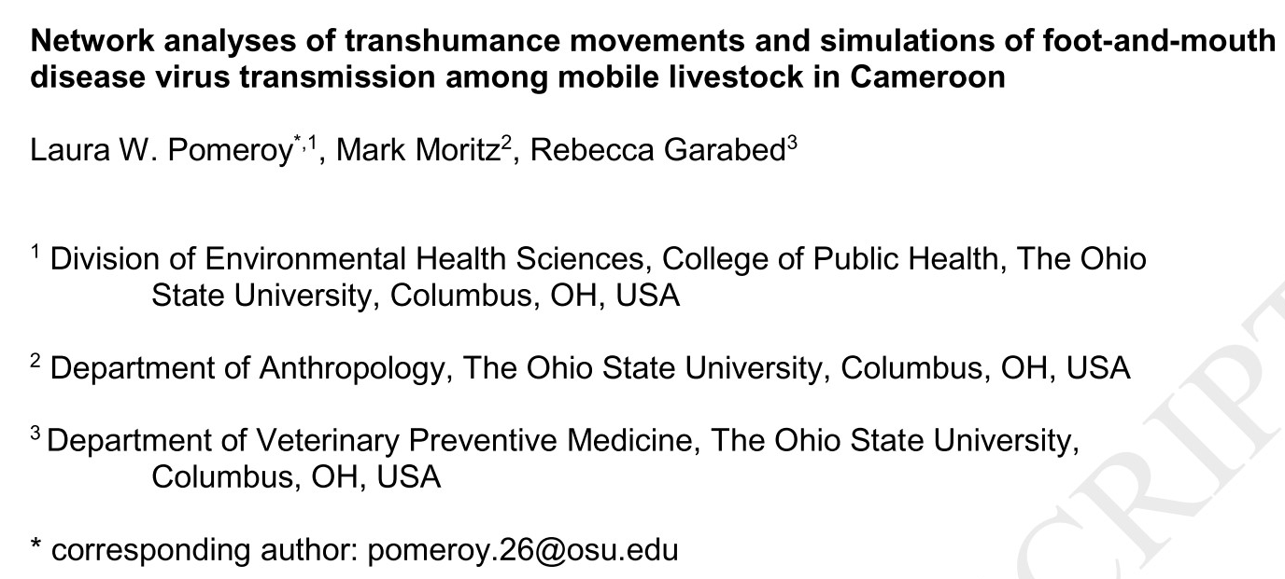



Disease spread models
Using R:
Statnet
siminf
Using Agent-based models:
http://contagion.principate.org/
GAMA Platform
NetLogo
https://gama-platform.github.io/wiki/Home
https://ccl.northwestern.edu/netlogo/

Slide 12
Questions?

